Slide 1
Visualization as a reporting tool
Columbia Stabile program, September 2014

Slide 2
Goals
Combine place and time to find the most representative or compelling examples to investigate
Link organizations and people in proper chronological order
Integrate structured and unstructured data
Move toward visualizations for publication, in print and on the Web

Slide 3
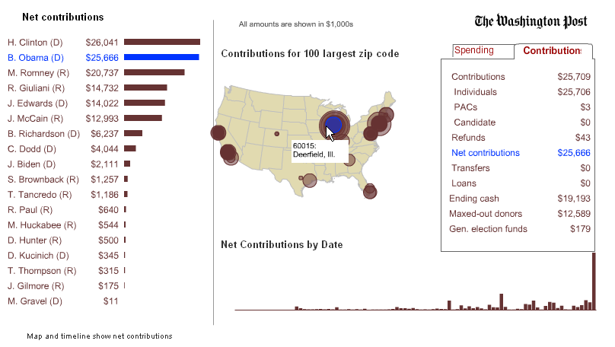
Notes:
Time and place are the most common forms of visualization in newsrooms – much of the rest it’s pretty easy to see without the visualization. Used on deadline during the presidential primary – reports come in over several hours on deadline, usually at night. Have to analyze it quickly so that a group of reporters can begin asking questions. No time to do analysis one by one, so used this tool to let them see the data summaries. (there was a separate are that they could dig into the details, but unfortunately they weren’t connected.) Can’t show it live – inside the firewall, and also it’s not interesting except during the primary, as it’s set to only look at the most recent filing.

Slide 4
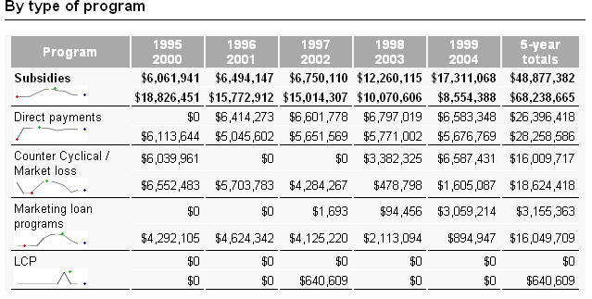
Notes:
Sparklines – Not a good solution to it yet. Only in Excel. There are some expensive packages that include them. Helps see things at a glance.

Slide 5
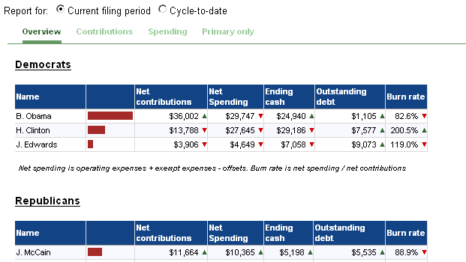
Notes:
Also used visual clues on deadline to show up, down, scale. These were both automatically populated by a database that was updated on deadline. None of this was ever published, it was simply used as a way to fill in the blanks in stories. We learned a lesson during this process – the website is actually less time-sensitive than the newsroom. They wanted to wait until everything was available before publishing – we needed to report on things as soon as they were filed.

Slide 6
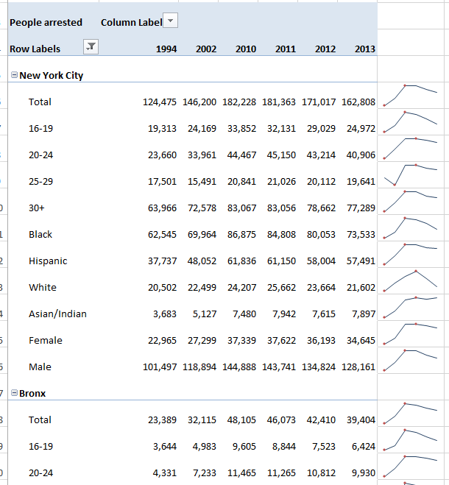

Slide 7
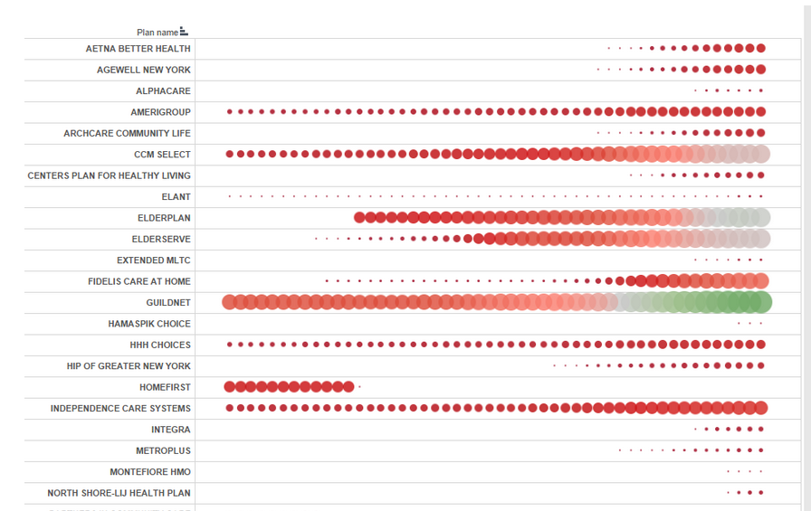
Notes:
An example from Tableau, simple in that it took no time and it was useful to decide which one to focus on – could see the ones that really exploded recently.

Slide 8
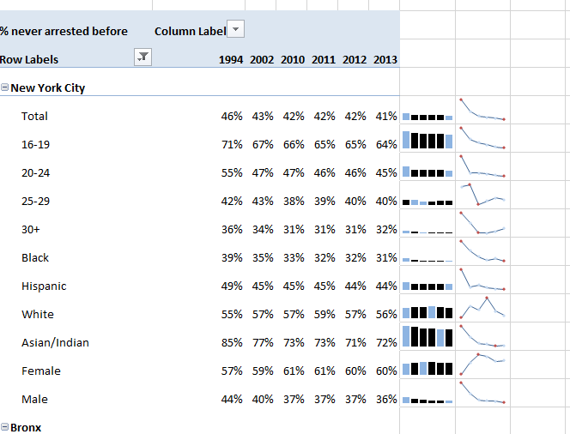

Slide 9
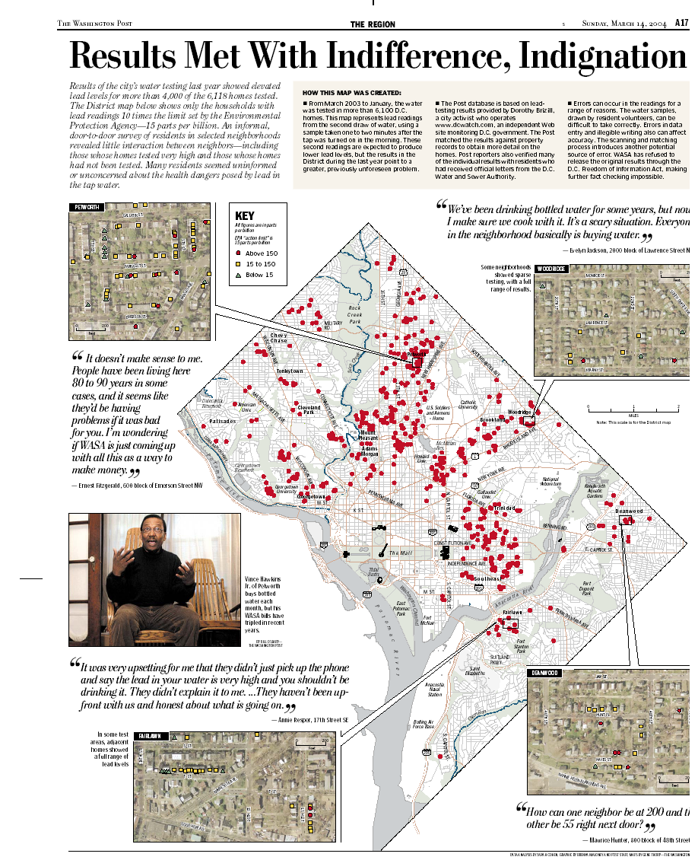
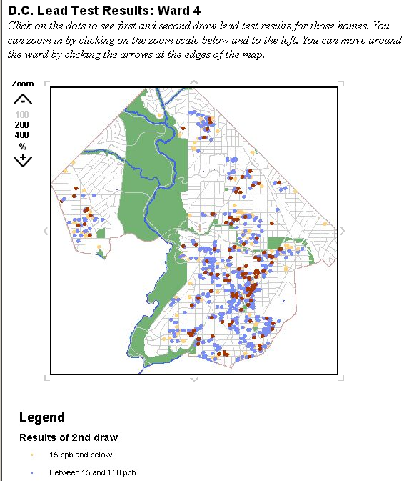
Notes:
Story on lead contamination in DC homes. The government had made 6,000 tests of lead, but kept the results secret. We obtained a printout, scanned them, geocoded them, and then sent reporters out with satellite images and results for 8 or 10 neighborhoods. This was done to test the accuracy as much as to write a story. It produced a story about the reaction families had when they discovered their neighbors’ water was contaminated, suggesting theirs might be as well. It was published on the web, as a public service, since the water company refused to release the results.

Slide 10
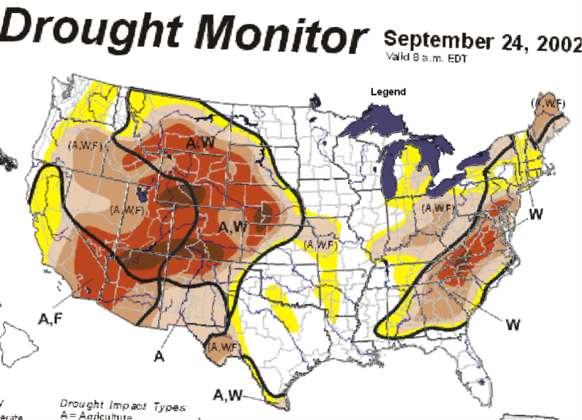
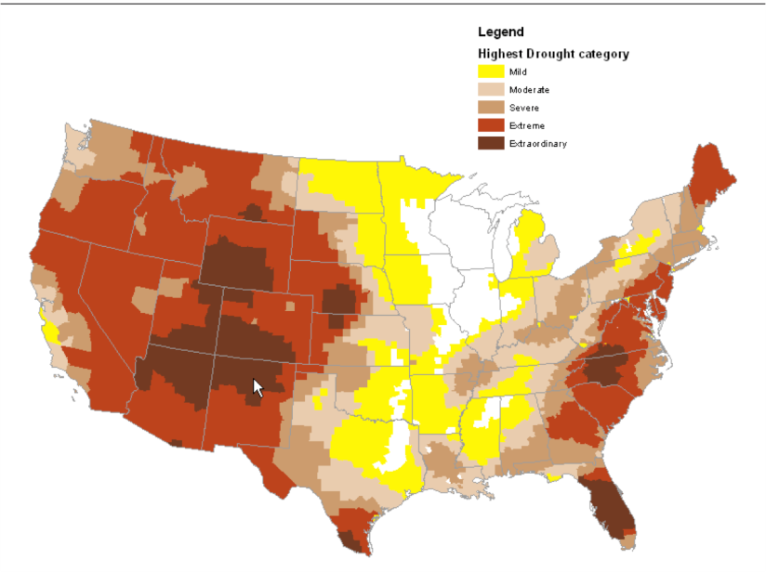
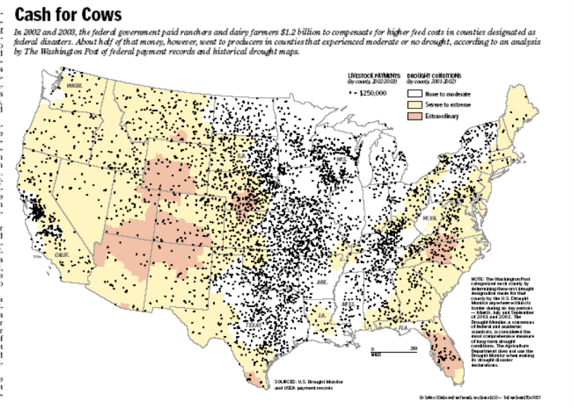

Slide 11
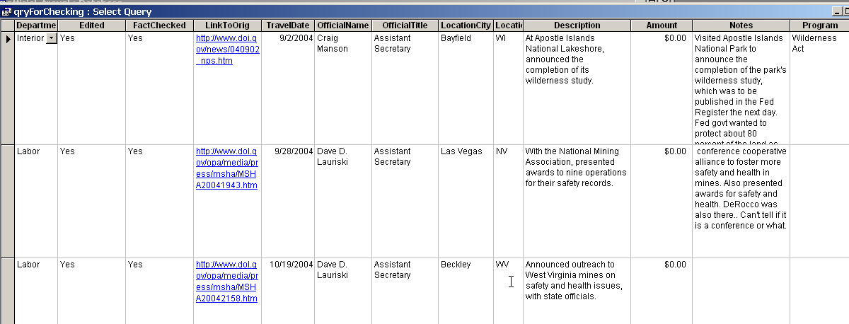
Notes:
Here’s what a little of that database looked like. Notice a couple of things here – mainly that it’s built to minimize errors in the paper: It has fields for “edited”, “factchecked” and a link to the original document that provided the detail. The “description” flowed directly into the graphic you see on the web.

Slide 12
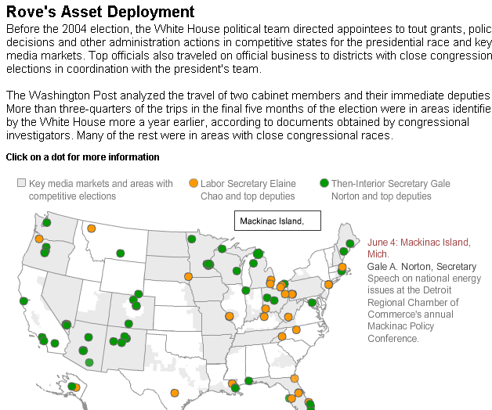
Notes:
This was a very quick-hit story. We had heard that there were efforts throughout the administration to direct grants to politically favored congressional districts and media markets, but couldn’t find any clear-cut evidence of it until we learned of the “Asset deployment teams” created by Karl Rove, and set up in most cabinet level departments. We also obtained some of the briefings, showing which markets he considered crucial and which states he was directing officials to travel to. We didn’t have time to get the proper public records – the travel records of the secretaries. But we could trace their movements in cases in which they wanted the public to know where they were. We tracked something like 200 trips made by top officials in two departments simply using press releases. Here’s the result.

Slide 13
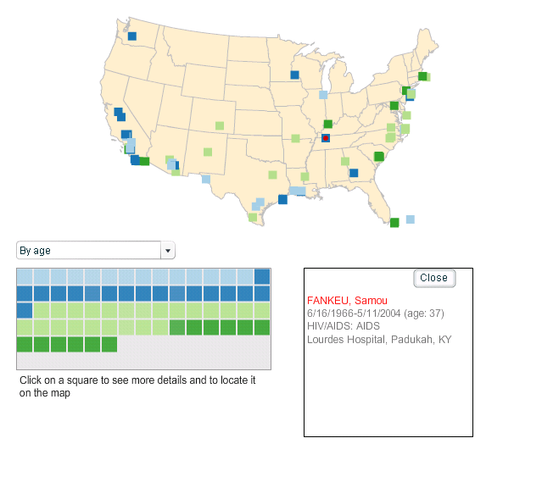
Notes:
More commonly, we need to compare place, time, and some kind of categorization. This was a tool we used for like 10 minutes in the newsroom to help us determine where to go to find detainees whose medical care might not have been proper. These are deaths of detainees, and we looked at them by age, by cause and by year. The idea – as ugly as it is – was that we saw very quickly this way that young, relatively healthy people were dying in the West. The East was older, sicker people. So our reporting was centered in the West.

Slide 14
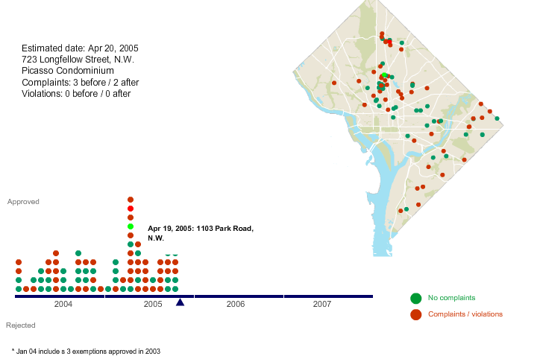
Notes:
A similar one is this one from a story last year on landlords in DC who were taking advantage of a government program, and in the process were allowing their buildings to deteriorate in order to convince residents to leave. The sereis, “Forced Out” focused on these buildings. But the app was used for a short time to see where the buildings were, and how it was distributed. This was based on a list from the government, property tax records, and housing code violation reports.

Slide 15
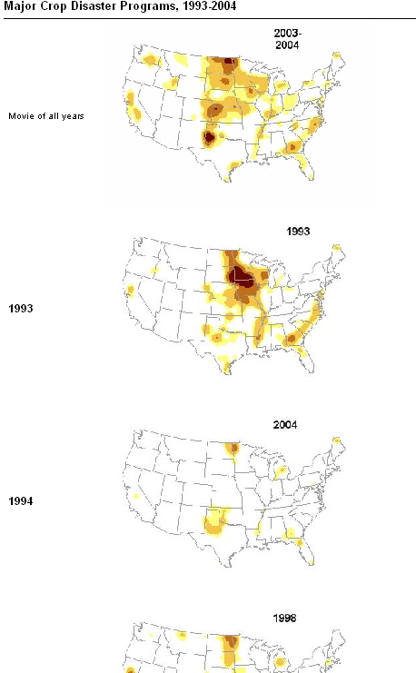
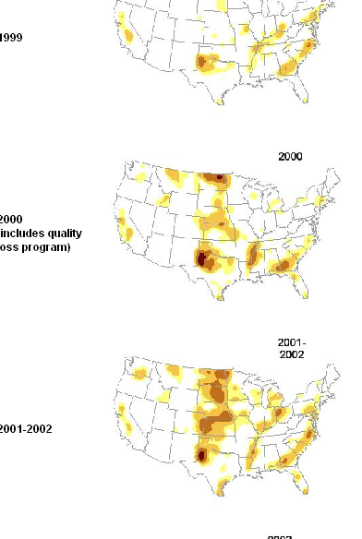
Notes:
Time and place are among the most important things we need in reporting – in this case, get a little of both. It’s also an example of small multiples, which are so useful for finding patterns. (Chase Davis has good small multiple examples). They are often ahard to make

Slide 16
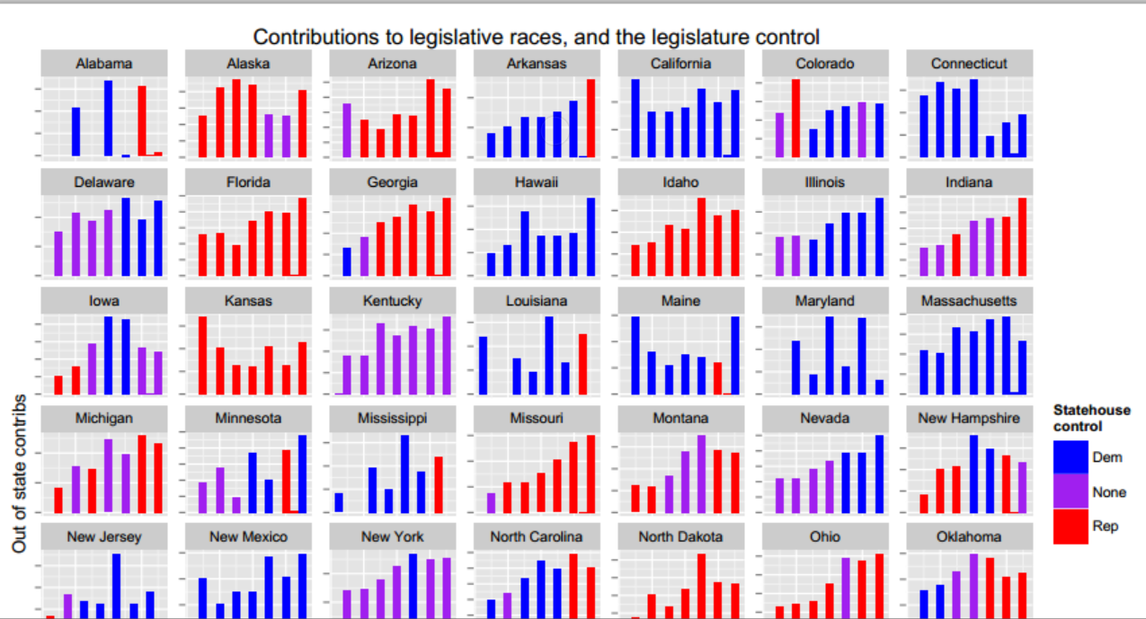

Slide 17
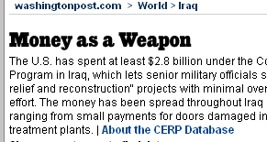
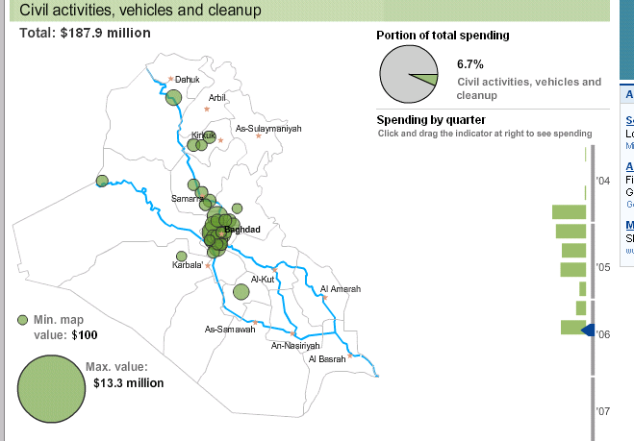
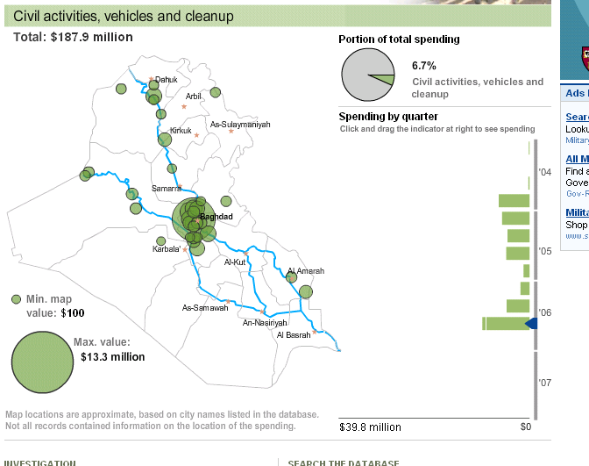
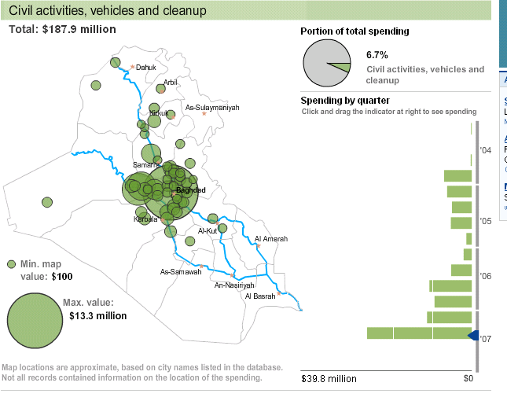
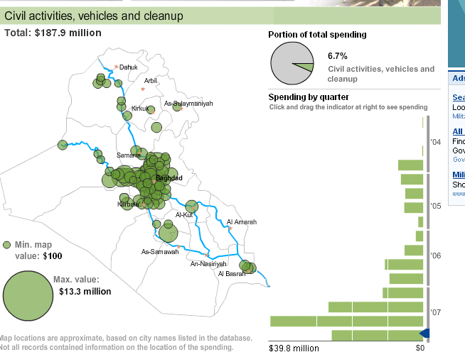
Notes:
This is another place and time analysis, where we knew we wanted to publish it in the end. The story was about a program that allows commanders in Iraq and Afghanistan for counterinsurgency purposes. They had no rules, only that they should spend it locally for the purpose of helping local people. Some was spent on cooling pools for bears and tigers at the zoo; “I love Iraq” t-shirts, Iraqi army action figures. We used this to explore the data and decide on an area to concentrate on (Ramadi), but then also published it with the database.

Slide 18
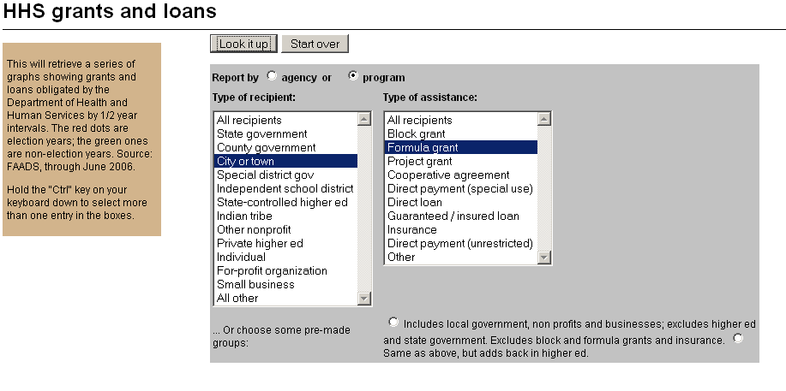
Notes:
Work on small multiples during reporting – this was an attempt to find the needle in the haystack – politically oriented grants. We’d heard there were a lot just before 2004 election.

Slide 19
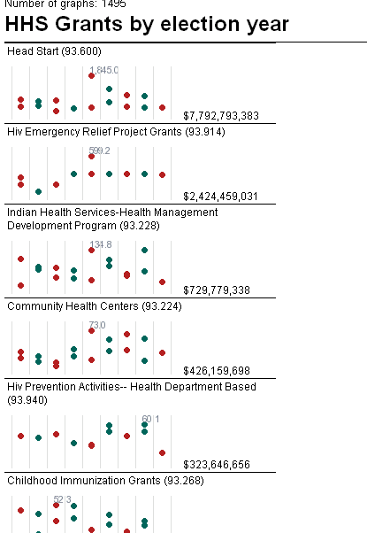
Notes:
Created 1495 small multiples on the screen to find areas in which grant spending spiked in the summer before the Bush presidential re-election – could just look at the ones at the top, since that was the most money down. See here, it wasn’t true – True at the end of Clinton admin, not at the end of Bush I. (Red dots an election year, by half-year totals.) This is done dynamically off of a database. The bad thing – not interactive. Can’t drill into it to see the grants.

Slide 20
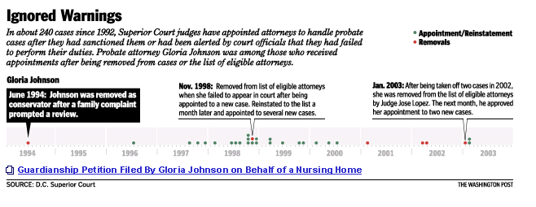
Notes:
More time-based graphics, this one in print: we did stories on court-appointed guardians who had neglected their charges. In this case, a judge removed this lawyer from one case for negligence, then appointed her to a new one the next day.

Slide 21
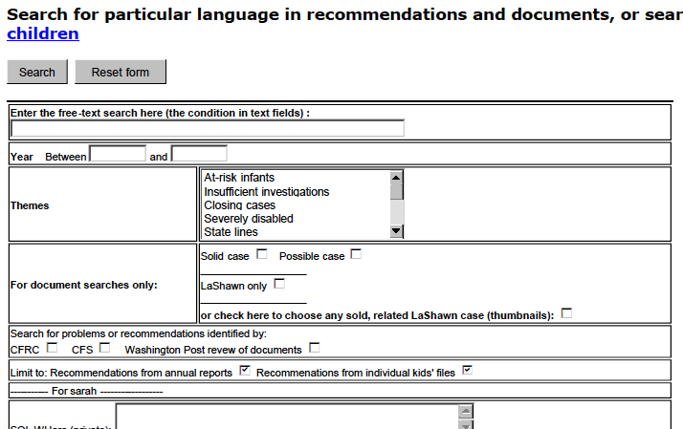
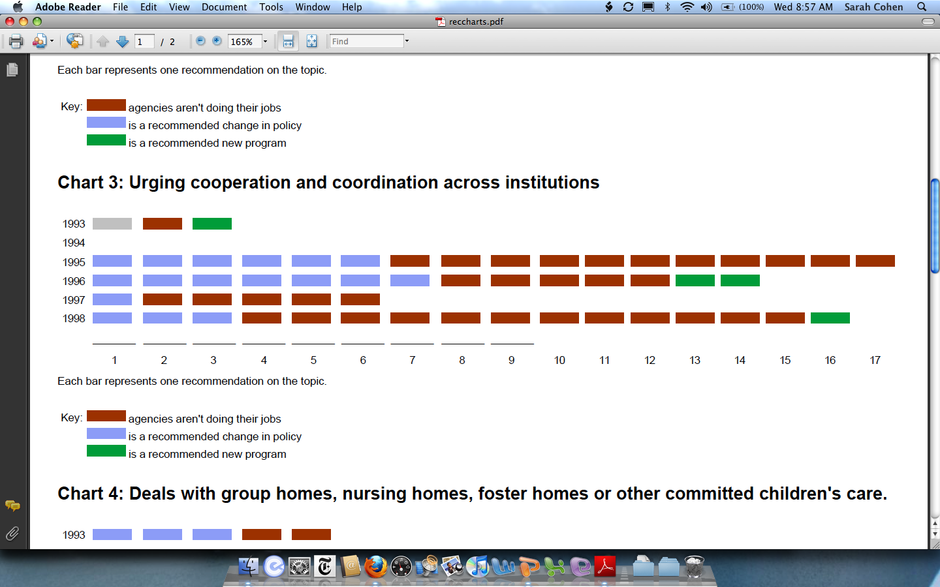
Notes:
This was a way to look at recommendations made by a government commission, where we were looking at these recommendations that had been repeated year after year, but had not helped protect children in the District.

Slide 22
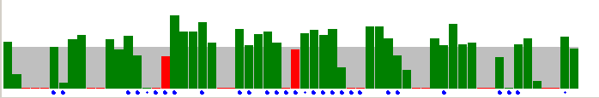
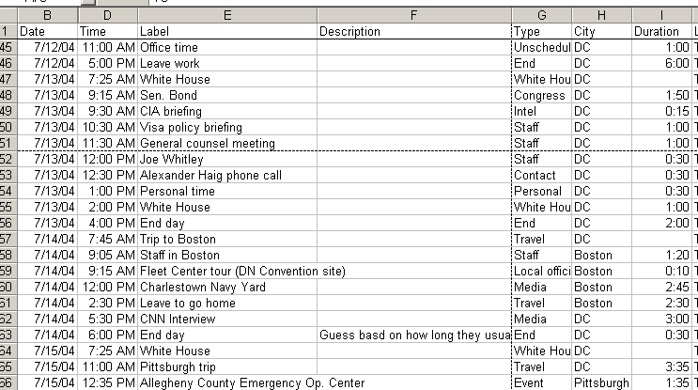
Notes:
This is my very, very crude attempt to do a visual analysis of my favorite story that was never published. This is Tom Ridge’s schedule during the presidential campaign, just after the Dept. of Homeland Security was created. The red ones are weekends, the blue dots are travel, and the gray area would be an 8-hour day. He didn’t work much – he spent a lot of time campaigning.

Slide 23
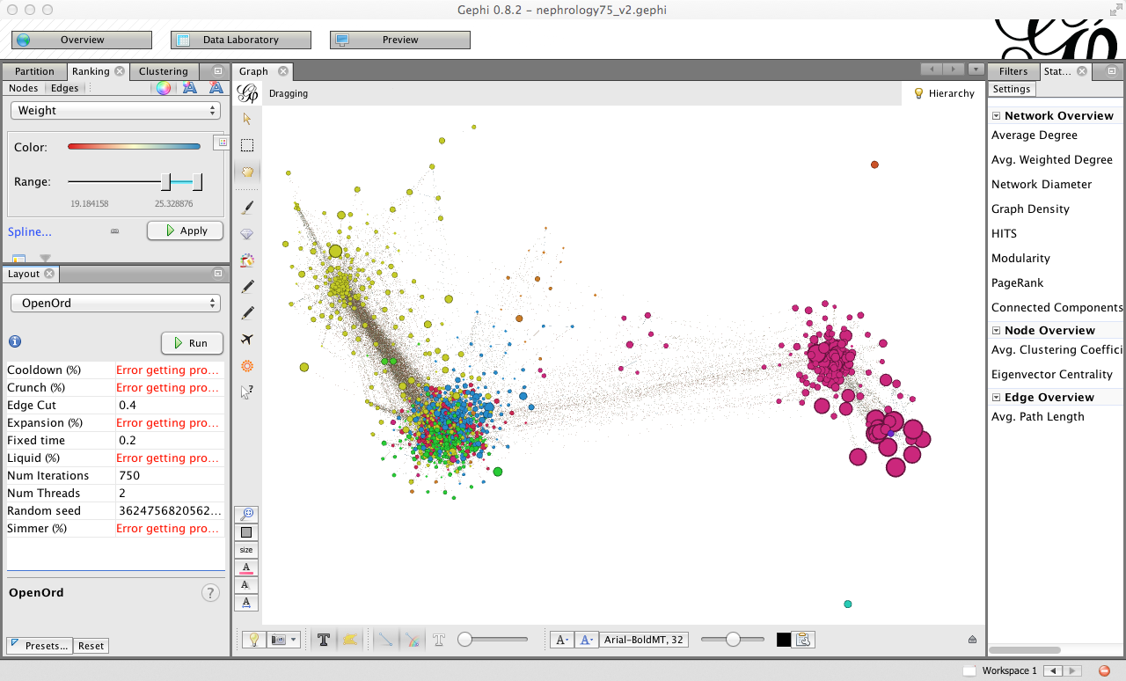

Slide 24
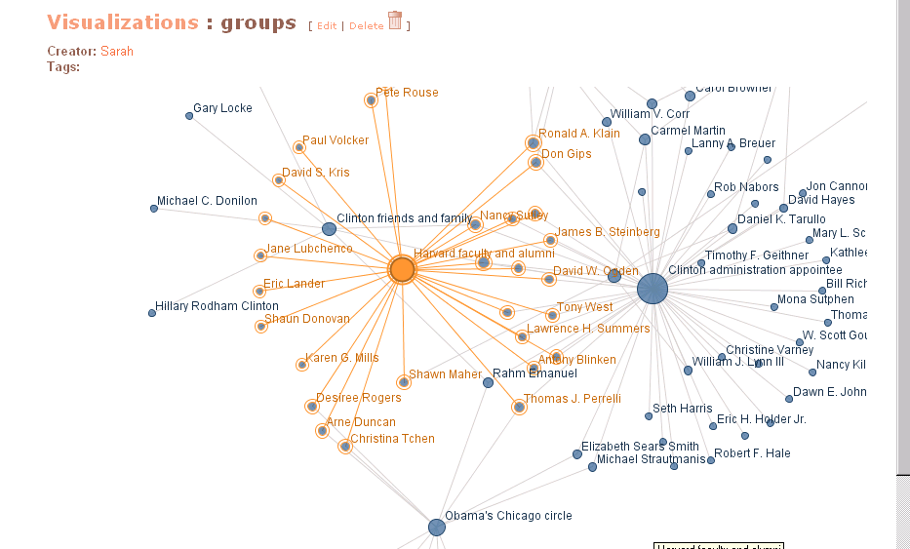
Notes:
Skipping network diagrams. Still way too difficult to get anything out of it. This had to be hand-coded – the analysis didn’t help. It’s been a big disappointment. This is from ManyEyes, which lots of people have used really well.
Treemaps:

Slide 25
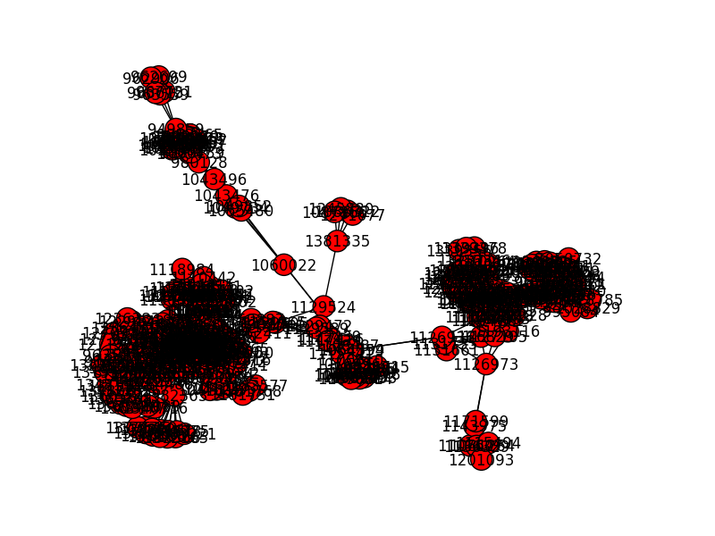

Slide 26
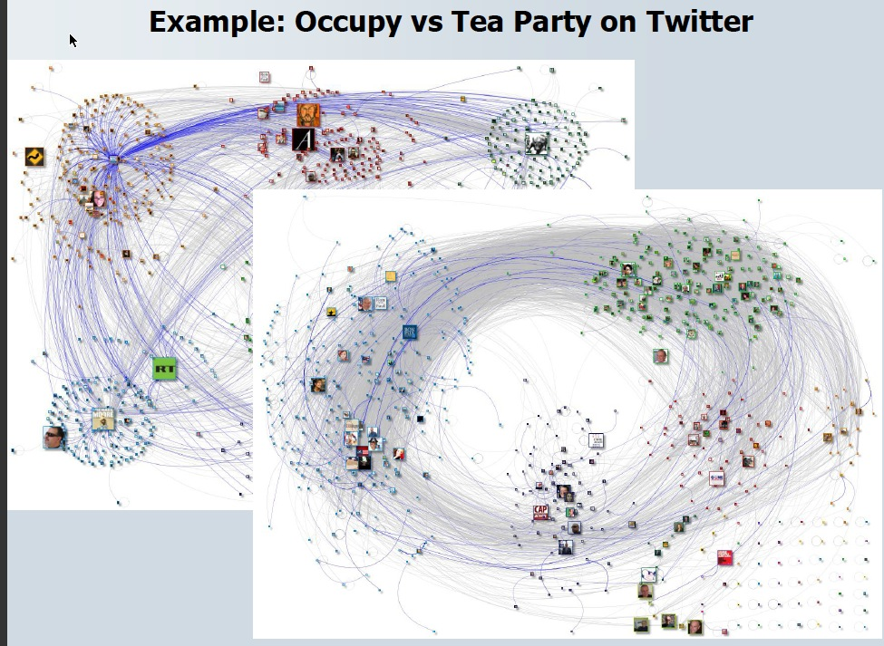

Slide 27
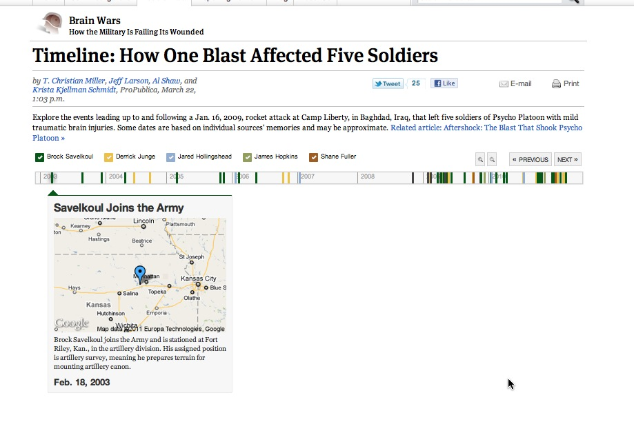

Slide 28
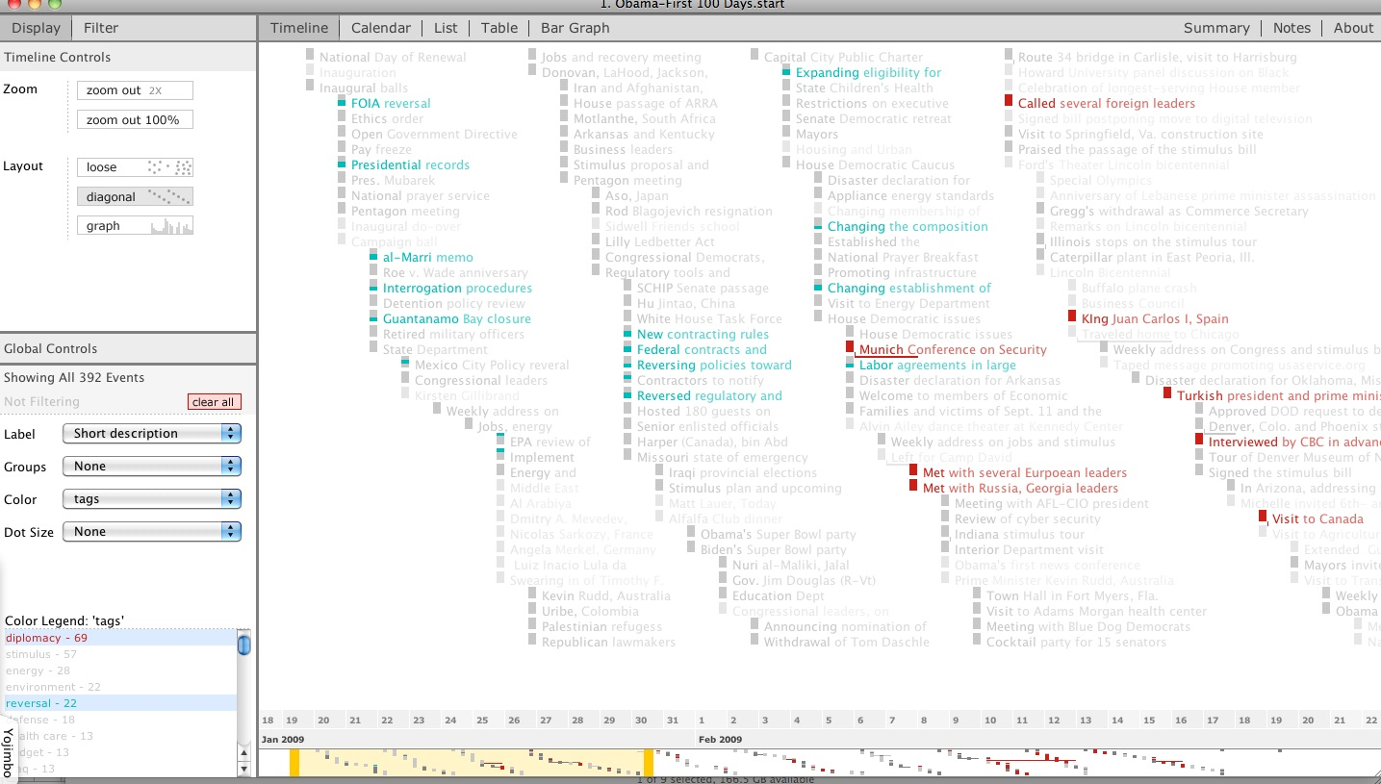
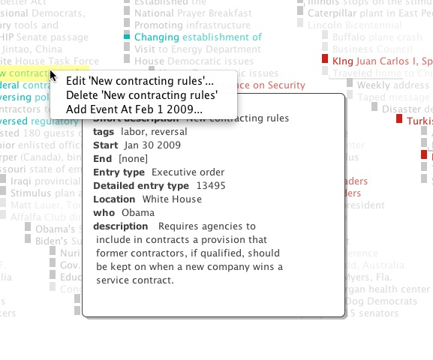
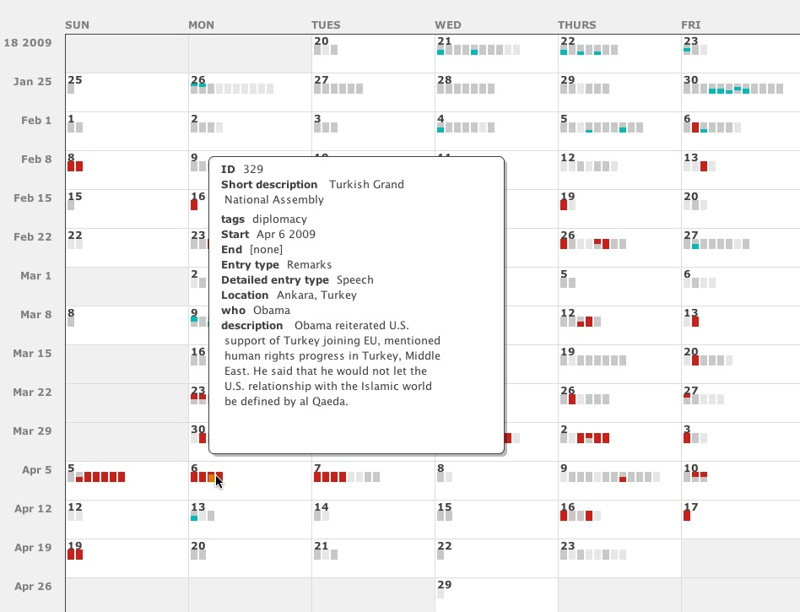

Slide 29
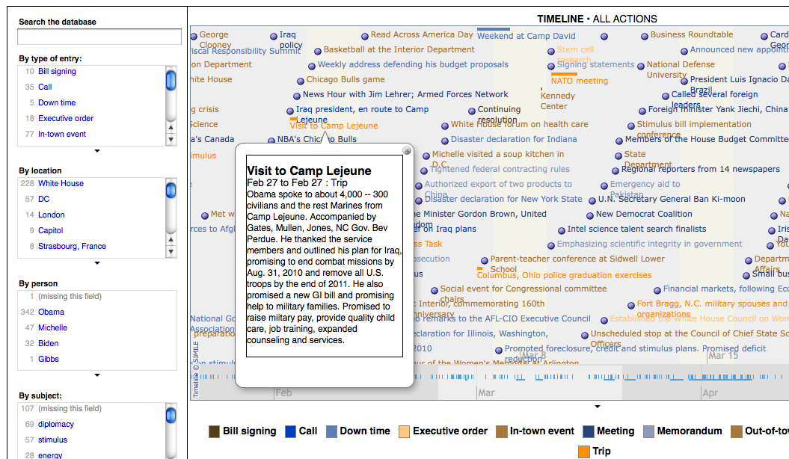
Resulting graphics at: http://www.washingtonpost.com/wp-srv/politics/obama/100days/
Notes:
Here’s another really bad attempt to visualize what Obama did in the first 100 days. The end result was something that we had to boil down into something like this:

Slide 30
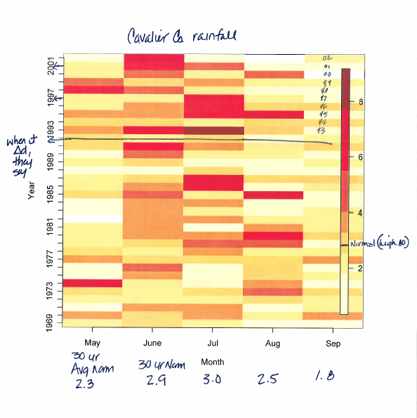
Notes:
Talking with weather experts, discovered it takes 30 years. This was an attempt to see how long the flooding had been going on. They said that after 1992, it flooded every year. You can definitely see the pattern. I tried using R for this, but couldn’t figure out how to do it very well.

Slide 31
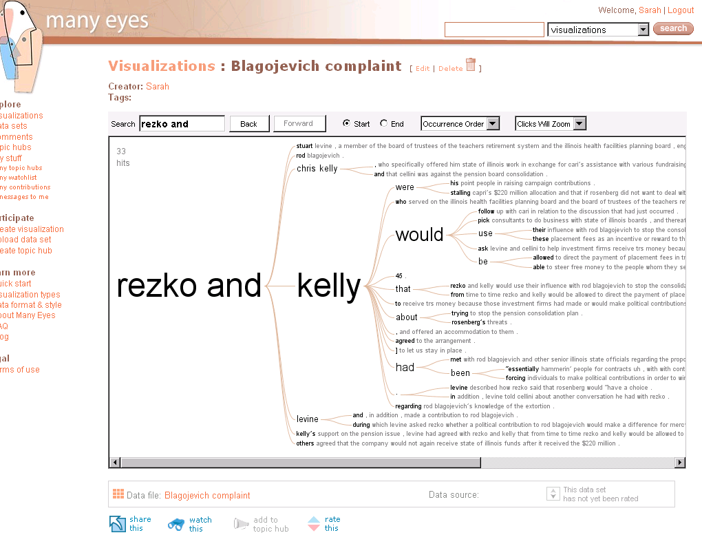
Notes:
Text / unstructured data visualizations – not very satisfying yet. This is about the best we can get. Next slide for the Holy Grail – parsing documents into names, places, dates, etc. and letting us visually drill into them.

Slide 32

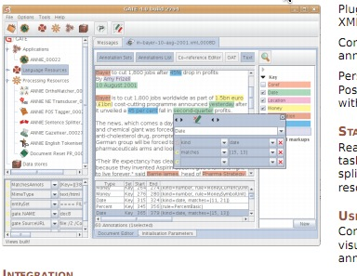

Slide 33
Tools
R graphics / Shiny
Tableau and Tableau Public
D3
Excel sparklines
HTML & CSS
Google Fusion Tables, charts & maps
GIS systems (ArcView, QGIS)
Gephi project for networks
Python and other programming languages

